Slide 1
Data Structure and
Algorithm
Welcome my presentation

Slide 2
Table of Content
A stack ADT, a concrete data structure for a First In First out (FIFO) queue.
2. Two sorting algorithms.
3. Two network shortest path algorithms.

Slide 3
01: A stack ADT, a concrete data structure for a First In First out (FIFO) queue.
To implement a stack Abstract Data Type (ADT) as a concrete data structure for a First In First Out (FIFO) queue, we can use two stacks. This approach simulates the queue behavior while leveraging the stack's LIFO characteristic.
- DSA (Data Structures and Algorithms) is the field of researching and developing data structures and algorithms, focusing on the arrangement, storage, effective data management, and optimizing the implementation of sports implementation Calculation. DSA is the foundation for software development and system performance improvement, helping to build complex applications

Slide 4
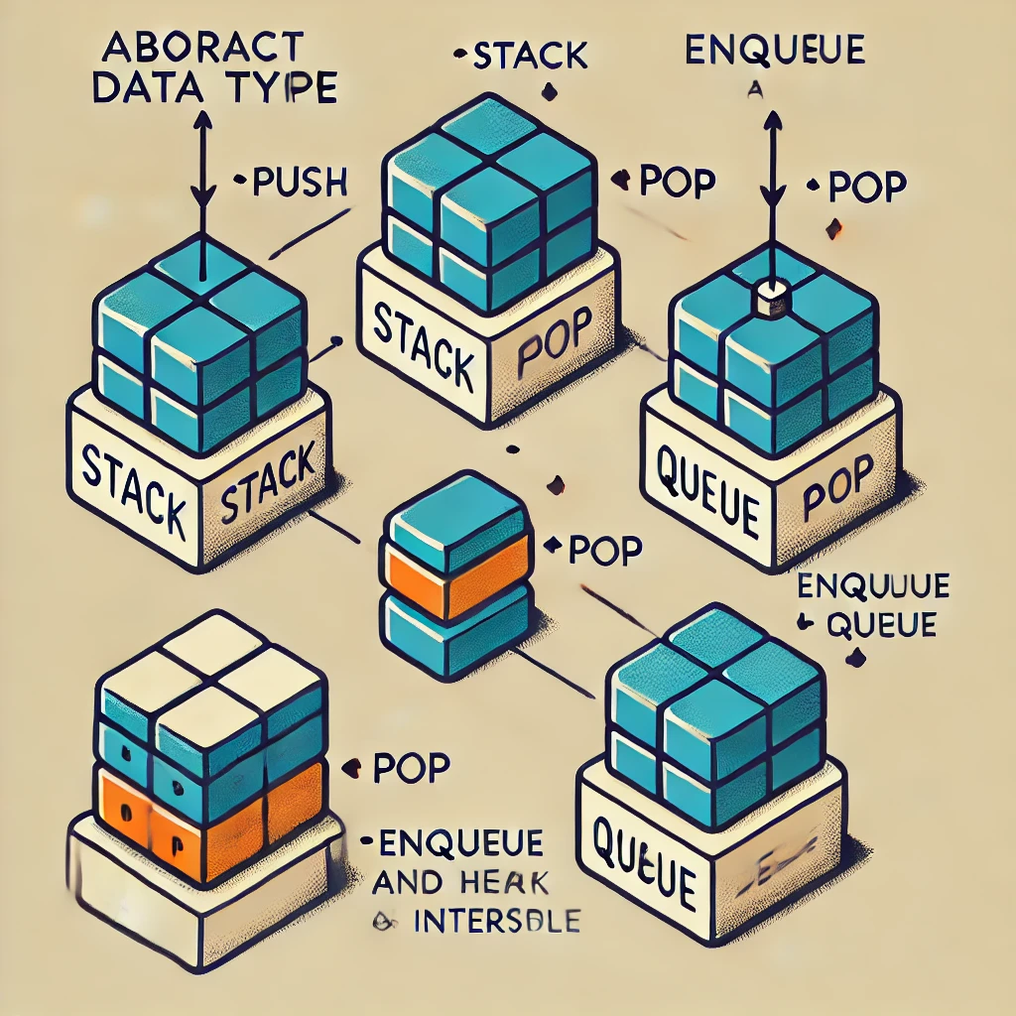
What is ADT?
An Abstract Data Type (ADT) is a theoretical model for a data structure that specifies the behavior of the data type (i.e., the operations it can perform) without detailing its implementation. ADTs define:
Operations: What actions can be performed (e.g., add, remove, update).
Behavior: The rules or constraints for each operation.
Data: The type of information that will be handled, though the exact data storage details are abstracted.

Slide 5
The stack and queue (FIFO) are two common types of ADT:
Stack (Stack): ADT obeys the principle of LIFO (Last in, First Out), meaning that the element added at the end of the stack will be taken first.
Demo code:
public class DemoStack { private int maxSize; private int top; private int[] stackArray; public DemoStack(int size) { maxSize = size; stackArray = new int[maxSize]; top = -1; }

Slide 6
Demo code:
public void push(int value) { if (top < maxSize - 1) { stackArray[++top] = value; } } public int pop() { if (top >= 0) { return stackArray[top--]; } return -1; }
push(int value) method:
Check if the stack is not full (top < maxSize - 1), then increment the top index by 1 and add the value to the top of the stack (stackArray[++top] = value).
pop() method:
Check if the stack is not empty (top >= 0), then take the element at the top (stackArray[top]) and decrement top by 1 (top--).
If the stack is empty, return -1.

Slide 7
public int peek() { if (top >= 0) { return stackArray[top]; } return -1; } public boolean isEmpty() { return (top == -1); }
peek() method:
Checks if the stack is not empty (top >= 0), returns the value of the element at the top of the stack (stackArray[top]).
If the stack is empty, returns -1.
isEmpty() method:
Checks if the stack is empty by seeing if the top index is equal to -1.
Returns true if the stack is empty, otherwise returns false.

Slide 8
The stack and queue (FIFO) are two common types of ADT:
Queue: ADT follows the FIFO (First In, First Out) principle, which means the element that is added first will be taken out first.
Demo code:

Slide 9
class ArrayQueue { private int[] queue; private int front, rear, size, capacity; public ArrayQueue(int capacity) { this.capacity = capacity; queue = new int[capacity]; front = 0; rear = -1; size = 0; }
class ArrayQueue: Defines a queue class using arrays.
private int[] queue: An array to store elements.
front, rear, size, capacity: Variables that track the front, rear, number of elements, and maximum capacity of the queue.
Constructor: Gets the capacity and initializes the queue, setting the index and size to 0.
enqueue(int data): Adds an element to the end of the queue. Checks if the queue is full and updates the rear index.
public void enqueue(int data) { if (size == capacity) { throw new IllegalStateException("Queue is full"); } rear = (rear + 1) % capacity; queue[rear] = data; size++; }

Slide 10
Compare different between Stack and Queue
Feature | Stack | Queue
Order Principle | LIFO (Last In, First Out) | FIFO (First In, First Out)
Primary Operations | Push (add item), Pop (remove item) | Enqueue (add item), Dequeue (remove item)
Usage Example | Function call stack, Undo operations | Task scheduling, Printer queues
Access Pattern | Only the last added item is accessible | Only the first added item is accessible
Real-Life Analogy | A stack of plates; you remove the top one first | A line at a ticket counter; first person served first

Slide 11
There are several ways to implement Stack and Queue, each with its own advantages.
- Stack Implementations
Array-Based Stack:
Uses a fixed-size array.
Simple and efficient for small, fixed-size stacks.
Limitation: If the array is full, it needs resizing or an overflow occurs.
Dynamic Array Stack:
Uses a resizable array (e.g., ArrayList in Java, Vector in C++).
Allows the stack to grow as needed.
Overhead: Resizing may involve costly memory reallocations.
Linked List Stack:
Uses a linked list where each node points to the next.
No fixed size, so it can grow dynamically.
Efficient for memory usage, as it only allocates memory as needed.
Two-Stack Implementation:
Often used to implement advanced operations.
For instance, two stacks can be used to simulate queue operations by managing elements between the two stacks.

Slide 12
There are several ways to implement Stack and Queue, each with its own advantages.
- Queue Implementations:
Array-Based Queue:
Uses a fixed-size array, with two pointers for the front and rear.
When the array is full, a circular queue or resizing is needed.
Suitable for fixed-size applications.
Circular Queue:
Uses an array and wraps around when reaching the end.
Allows better utilization of array space without resizing.
Efficient for queues that repeatedly add and remove items.
Dynamic Array Queue:
Uses a resizable array to allow the queue to grow.
Overhead: Requires memory reallocation and shifting of elements.
Linked List Queue:
Uses a linked list where each node represents an element.
No fixed size, so it can dynamically grow as needed.
Suitable for queues where memory flexibility is preferred.

Slide 13
public int dequeue() { if (isEmpty()) { throw new IllegalStateException("Queue is empty"); } int data = queue[front]; front = (front + 1) % capacity; size--; return data; }
dequeue(): Removes and returns the element at the front of the queue.
Check for Empty: Throws an exception if the queue is empty.
Get Data: Stores the value at the front position.
Update Index: Moves the front to the next position, using modulo to return to the front of the array when needed.
Decrease Size: Decreases the size after deletion.
peek(): Returns the element at the front of the queue without removing it.
Check for Empty: Throws an exception if the queue is empty.
isEmpty(): Checks if the queue is empty.
Returns: A boolean value based on the size.
getSize(): Returns the number of elements currently in the queue.
public int peek() { if (isEmpty()) { throw new IllegalStateException("Queue is empty"); } return queue[front]; } public boolean isEmpty() { return size == 0; } public int getSize() { return size; }

Slide 14

2.Two sorting algorithms.
- Sorting algorithms are methods for rearranging a collection of data (such as a list or array) in ascending or descending order. There are many sorting algorithms, each with its own advantages and disadvantages depending on the use case and data type.
The two sorting algorithms are:
Bubble Sort
Insertion Sort

Slide 15
Bubble Sort:
Compare each pair of adjacent elements and swap them if they are not in the desired order.
Simple but slow for large datasets.
Complexity: O(n²) in average and worst case.
Insertion Sort:
Find the smallest (or largest) element and place it at the head of the list, repeat for the remaining elements.
More efficient than Bubble Sort, but still slow for large datasets.
Complexity: O(n²).

Slide 16

Demo Code:
package DemoCode; //Insertion sort public class Main4 { public static void main(String[] args) { int [] arr = {29, 12, 45, 7, 33}; int n = arr.length; System.out.println("Array after sorting"); for(int num: arr){ System.out.print(num + " "); } for(int i = 1; i < n; i++){ int key = arr[i]; int j = i - 1; while (j >= 0 && arr[j] > key) { arr[j + 1] = arr[j]; j--; } arr[j + 1] = key; } System.out.println("\nArray after sorting"); for(int num: arr){ System.out.print(num + " "); } } }
Array after sorting 29 12 45 7 33 Array after sorting 7 12 29 33 45

Slide 17
Demo Code:
package DemoCode; //Bubble sort public class Main3 { public static void main(String[] args) { int [] arr = {4, 7, -9, 2, 6, 1}; int n = arr.length; System.out.println("Array before sorting"); for (int num: arr){ System.out.print(num + "\t"); } for(int i = 0; i < n - 1; i++){ for(int j = 0; j < n - i -1; j++){ if (arr[j] < arr[j+1]){ int temp = arr[j]; arr[j] = arr[j+1]; arr[j + 1] = temp; } } } System.out.println("\nArray after sorting"); for(int num: arr){ System.out.print(num + "\t"); } } }
Array before sorting 4 7 -9 2 6 1 Array after sorting 7 6 4 2 1 -9

Slide 18
Comparing the complexity between the two algorithms:
Criteria | Bubble Sort | Insertion Sort
Best Case | O(n) (if optimized) | O(n) (already sorted or nearly sorted data)
Average Case | O(n²) | O(n²)
Worst Case | O(n²) | O(n²)
Space Complexity | O(1) (in-place sorting) | O(1) (in-place sorting)
Operation Type | Swaps adjacent elements repeatedly | Shifts elements to find the right position
Efficiency | Generally slower, as it involves many swaps | Generally faster due to fewer swaps
Use Cases | Mostly educational, rarely used in practice | Suitable for small or nearly sorted arrays

Slide 19
3. Two network shortest path algorithms. - Two typical algorithms:
- The shortest path algorithm is an important technique in graph theory, used to find the path with the smallest total weight between two points (vertices) in a network. The shortest path has wide applications in routing systems, maps, transportation networks, and many other fields.
Algorithm 1: Dijkstra's Algorithm
Algorithm 2: Prim-Jarnik Algorithm

Slide 20
Dijkstra's Algorithm
- Dijkstra's algorithm finds the shortest path from a source node to all other nodes in a weighted, non-negative edge network. It operates by iteratively selecting the node with the minimum tentative distance and updating the shortest known paths to each neighbor of that node.
Steps:
Initialize distances from the source to all nodes as infinity (except the source itself, set to 0).
Mark all nodes as unvisited and select the source node.
For the current node, calculate the distance to each neighbor. If a shorter path is found, update it.
Mark the current node as visited and select the unvisited node with the smallest tentative distance.
Repeat until all nodes are visited or the shortest path is found.
Use Cases: GPS navigation, network routing protocols.

Slide 21
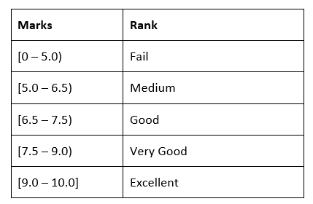
Implement a complex ADT and algorithm in an executable programming language to solve a well-defined problem
Define the Problem
The problem is to create a program that manages a list of students and their academic performance. The program should allow users to:
Add, edit, delete, search, and sort student records.

Slide 22
Implement the ADT
ADT: Node
public class Node { Student student; Node next; public Node(Student student) { this.student = student; this.next = null; } }

Slide 23
ADT: Student
public class Student { private String id; private String name; private double marks; private String rank; public Student(String id, String name, double marks) { this.id = id; this.name = name; this.marks = marks; this.rank = this.calculateRank(marks); } private String calculateRank(double marks) { if (marks >= 0.0 && marks < 5.0) { return "Fail"; } else if (marks >= 5.0 && marks < 6.5) { return "Medium"; } else if (marks >= 6.5 && marks < 7.5) { return "Good"; } else { return marks >= 7.5 && marks < 9.0 ? "Very Good" : "Excellent"; } }

Slide 24
ADT: Student
public String getId() { return this.id; } public String getName() { return this.name; } public double getMarks() { return this.marks; } public String getRank() { return this.rank; } public void setName(String name) { this.name = name; } public void setMarks(double marks) { this.marks = marks; this.rank = this.calculateRank(marks); } }

Slide 25
ADT: StudentStack
public class StudentStack { private Node top = null; private int size = 0; public StudentStack() { } public void push(Student student) { Node newNode = new Node(student); newNode.next = this.top; this.top = newNode; ++this.size; } public Student pop() { if (this.isEmpty()) { System.out.println("Stack Underflow! No students to remove."); return null; } else { Student poppedStudent = this.top.student; this.top = this.top.next; --this.size; return poppedStudent; } }

Slide 26
ADT: StudentStack
public Student peek() { if (this.isEmpty()) { System.out.println("Stack is empty!"); return null; } else { return this.top.student; } } public boolean isEmpty() { return this.top == null; } public void displayStudents() { if (this.isEmpty()) { System.out.println("No students in the stack."); } else { System.out.println("Students in Stack:"); for(Node current = this.top; current != null; current = current.next) { System.out.println(current.student); } }

Slide 27
Algorithm: StudentManagement
public void updateStudent(String id, String newName, double newMarks) { StudentStack tempStack = new StudentStack(); boolean found = false; while (!this.students.isEmpty()) { Student student = this.students.pop(); if (student.getId().equals(id)) { student.setName(newName); student.setMarks(newMarks); found = true; } tempStack.push(student); } while (!tempStack.isEmpty()) { this.students.push(tempStack.pop()); } if (!found) { System.out.println("Student with ID " + id + " not found."); } else { System.out.println("Student with ID " + id + " has been updated."); } }
class StudentManagement { private StudentStack students = new StudentStack(); public void addStudent(Student student) { this.students.push(student); System.out.println("Added: " + student); }

Slide 28
Algorithm: StudentManagement
public Student searchStudent(String id) { StudentStack tempStack = new StudentStack(); Student foundStudent = null; while (!this.students.isEmpty()) { Student student = this.students.pop(); if (student.getId().equals(id)) { foundStudent = student; } tempStack.push(student); } while (!tempStack.isEmpty()) { this.students.push(tempStack.pop()); } if (foundStudent == null) { System.out.println("Student with ID " + id + " not found."); } return foundStudent; }

Slide 29
Algorithm: StudentManagement
public void deleteStudent(String id) { StudentStack tempStack = new StudentStack(); boolean found = false; while (!this.students.isEmpty()) { Student student = this.students.pop(); if (!student.getId().equals(id)) { tempStack.push(student); } else { found = true; } } while (!tempStack.isEmpty()) { this.students.push(tempStack.pop()); } if (found) { System.out.println("Deleted student with ID " + id); } else { System.out.println("Student with ID " + id + " not found."); } }

Slide 30
Algorithm: StudentManagement
public void displayStudents() { this.students.displayStudents(); } public void sortStudents(int numStudents) { Student[] studentArray = new Student[numStudents]; StudentStack tempStack = new StudentStack(); for (int i = 0; i < numStudents && !this.students.isEmpty(); i++) { studentArray[i] = this.students.pop(); tempStack.push(studentArray[i]); } while (!tempStack.isEmpty()) { this.students.push(tempStack.pop()); } long startTime, endTime, duration;

Slide 31
Algorithm: StudentManagement
private void bubbleSort(Student[] array) { int n = array.length; for (int i = 0; i < n - 1; i++) { for (int j = 0; j < n - 1 - i; j++) { if (array[j].getMarks() > array[j + 1].getMarks()) { Student temp = array[j]; array[j] = array[j + 1]; array[j + 1] = temp; } } } } private void mergeSort(Student[] array, int left, int right) { if (left < right) { int mid = (left + right) / 2; mergeSort(array, left, mid); mergeSort(array, mid + 1, right); merge(array, left, mid, right); } }

Slide 32
private void merge(Student[] array, int left, int mid, int right) { int n1 = mid - left + 1; int n2 = right - mid; Student[] leftArray = new Student[n1]; Student[] rightArray = new Student[n2]; for (int i = 0; i < n1; i++) { leftArray[i] = array[left + i]; } for (int i = 0; i < n2; i++) { rightArray[i] = array[mid + 1 + i]; } int i = 0, j = 0, k = left; while (i < n1 && j < n2) { if (leftArray[i].getMarks() <= rightArray[j].getMarks()) { array[k] = leftArray[i]; i++; } else { array[k] = rightArray[j]; j++; } k++; } while (i < n1) { array[k] = leftArray[i]; i++; k++; } while (j < n2) { array[k] = rightArray[j]; j++; k++; } }
Algorithm: StudentManagement

Slide 33
Algorithm: StudentManagement
private void quickSort(Student[] array, int low, int high) { if (low < high) { int pi = partition(array, low, high); quickSort(array, low, pi - 1); quickSort(array, pi + 1, high); } }
private int partition(Student[] array, int low, int high) { Student pivot = array[high]; int i = (low - 1); for (int j = low; j < high; j++) { if (array[j].getMarks() <= pivot.getMarks()) { i++; Student temp = array[i]; array[i] = array[j]; array[j] = temp; } } Student temp = array[i + 1]; array[i + 1] = array[high]; array[high] = temp; return i + 1; } }

Slide 34
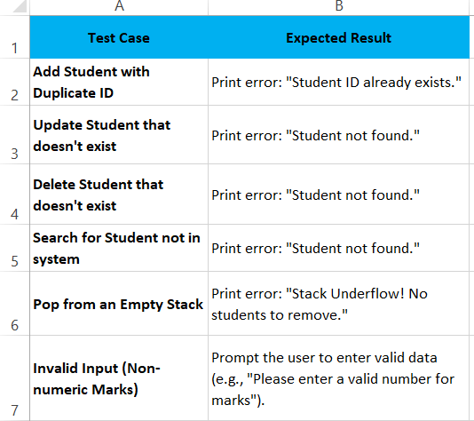
Test the error handling code

Slide 35
Algorithm: StudentManagement
// Bubble Sort startTime = System.nanoTime(); bubbleSort(studentArray.clone()); endTime = System.nanoTime(); duration = endTime - startTime; System.out.println("Bubble Sort time: " + duration + " nanoseconds");
// Quick Sort startTime = System.nanoTime(); quickSort(studentArray.clone(), 0, studentArray.length - 1); endTime = System.nanoTime(); duration = endTime - startTime; System.out.println("Quick Sort time: " + duration + " nanoseconds"); }
// Merge Sort startTime = System.nanoTime(); mergeSort(studentArray.clone(), 0, studentArray.length - 1); endTime = System.nanoTime(); duration = endTime - startTime; System.out.println("Merge Sort time: " + duration + " nanoseconds");

Slide 36
Time Complexity and example
Below is the code of 3 algorithms (Bubble, Merge, Quick) and compare the time complexity of the current student management project:
Compare the execution time of the 3 algorithms with random students after running
--- MENU ---
1. Add Student
2. Update Student
3. Delete Student
4. Search Student by ID
5. Display All Students
6. Sort Students
7. Exit
8. Add Random Students Automatically
Choose an option: 6

Slide 37
Time Complexity and example
Case1: 10 Student
Bubble Sort time: 6400 nanoseconds
Merge Sort time: 43700 nanoseconds
Quick Sort time: 6501 nanoseconds
Case2: 100 Student
Bubble Sort time: 492800 nanoseconds
Merge Sort time: 189401 nanoseconds
Quick Sort time: 82400 nanoseconds
Case3: 1000Student
Bubble Sort algorithm execution time is: 8443500 nanoseconds
Merge Sort algorithm execution time is: 1051900 nanoseconds
Quick Sort algorithm execution time is: 600199 nanoseconds

Slide 38
Space Complexity and example
Example: Consider the following space complexities for the three sorting algorithms:
Bubble Sort (O(1)): Bubble Sort has a space complexity of O(1) because it only requires a constant amount of additional space for swapping elements in place, irrespective of the input size.
Merge Sort (O(n)): Merge Sort has a space complexity of O(n) because it requires additional space for the temporary arrays used during the merging process. This space grows linearly with the size of the input array.
Quick Sort (O(log n)): Quick Sort has a space complexity of O(log n) in its optimized form (using an in-place partitioning strategy). This space is needed for the recursion stack during the algorithm's execution.

Slide 39
Evaluate three benefits
Portability
Benefit:
Code written with abstract data types (ADTs) can be executed on various systems as long as the implementation adheres to the same interface.
For example, a Queue ADT defined in one environment (e.g., Java) can be re-implemented in another (e.g., Python) without altering how the ADT is used in the program.
Example: A priority queue defined as an ADT can be implemented using a heap or a sorted list depending on the environment, but the interface for operations like enqueue() and dequeue() remains the same.

Slide 40
Evaluate three benefits
Reusability
Benefit:
Developers can use the same ADT definitions in different parts of a system or entirely different projects, reducing duplication and improving development efficiency.
For instance, a Stack ADT can be implemented once and reused for different purposes, such as evaluating mathematical expressions or managing function calls.
Example: A Dictionary ADT could be reused in both a spell-checking application and a data-indexing application. Although the underlying implementation (hash table or binary search tree) may vary, the interface remains consistent.

Slide 41
Evaluate three benefits
Maintainability
Benefit:
Developers can use the same ADT definitions in different parts of a system or entirely different projects, reducing duplication and improving development efficiency.
For instance, a Stack ADT can be implemented once and reused for different purposes, such as evaluating mathematical expressions or managing function calls.
Example: A Dictionary ADT could be reused in both a spell-checking application and a data-indexing application. Although the underlying implementation (hash table or binary search tree) may vary, the interface remains consistent.

Slide 42
Thank for listening

